Slide 1

A gamified introduction to Python Programming Lecture 13 Importing and Project Management
Matthieu DE MARI – Singapore University of Technology and Design

Slide 2

Outline (Chapter 13)
What is the import procedure doing exactly?
How to organize your different codes for better project organizing?
Our first mini-project.

Slide 3
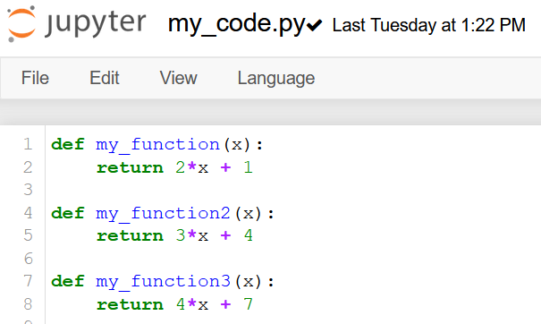
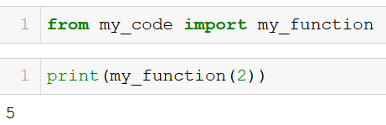
The import procedure
my_code.py file
The import procedure is used to import functions defined in external .py files.
To demonstrate, we have defined a my_code.py file with three functions.
We can then import one of these functions in our Notebook, by using the from … import … command.
In our notebook

Slide 4
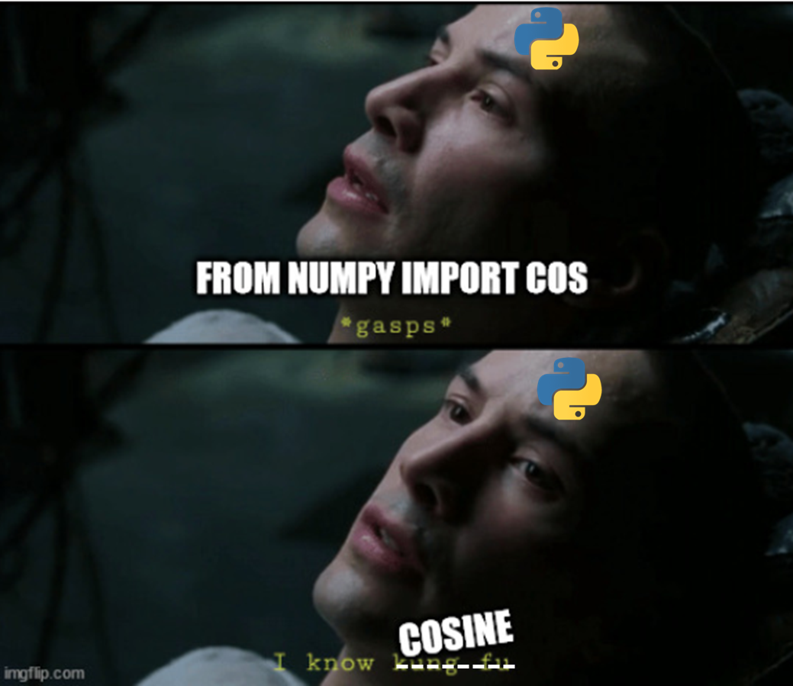



The import procedure
Operator: Cosine function coming right up!

Slide 5
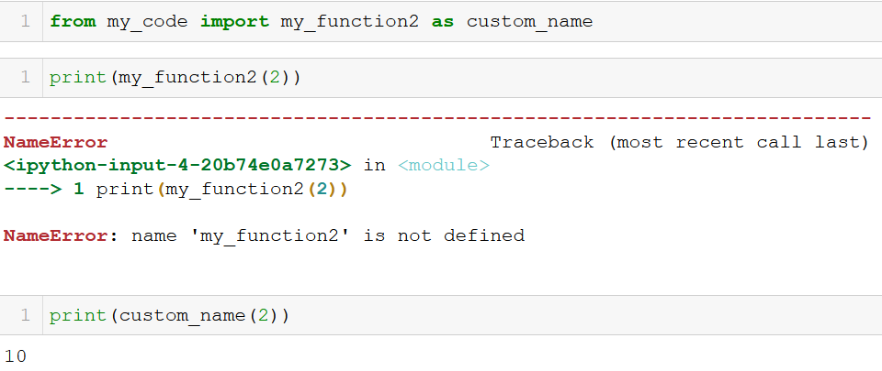
Importing as
my_code.py file
If needed, we can import and rename a function by using the as keyword after an import.
The whole command then reads from … import … as …
Note: if you rename the function, its calling name changes to the alias you specified.
In our notebook

Slide 6
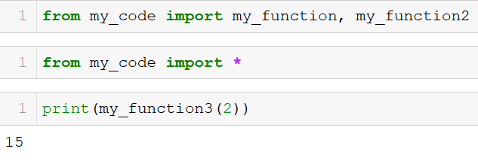
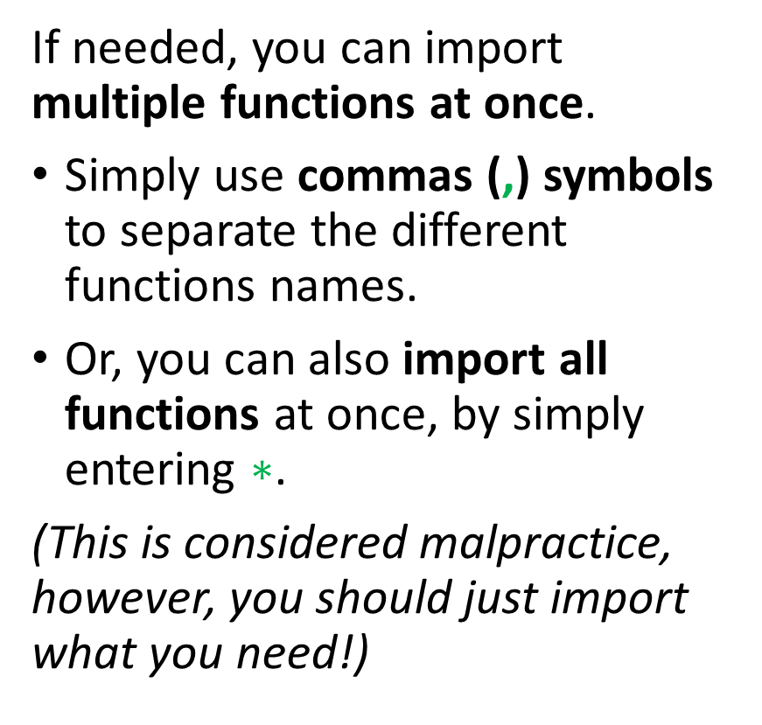
Importing several functions
my_code.py file
If needed, you can import multiple functions at once.
Simply use commas (,) symbols to separate the different functions names.
Or, you can also import all functions at once, by simply entering $∗$.
(This is considered malpractice, however, you should just import what you need!)
In our notebook

Slide 7
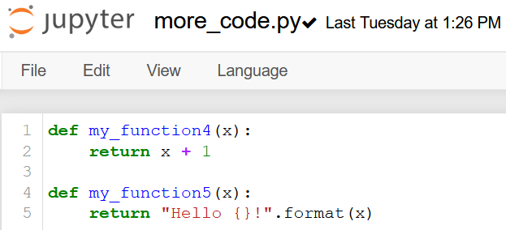
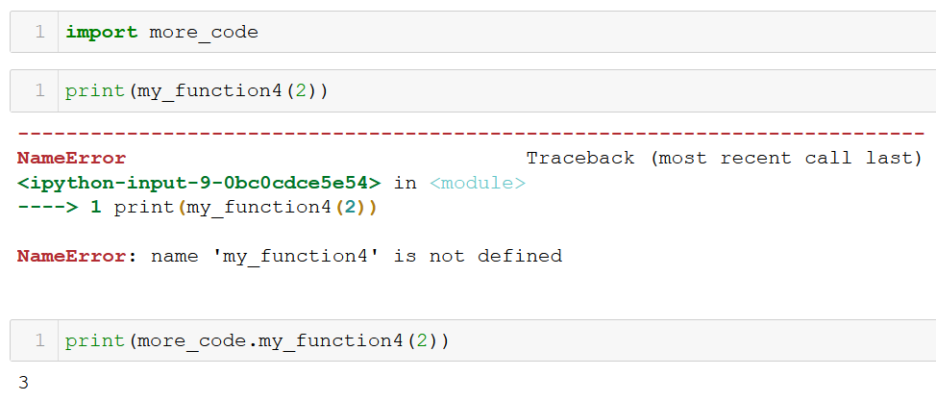
Importing an entire module
more_code.py file
You can also import a whole file or library as a module.
To do so, simply start with import instead of from.
By doing so, you import all the functions, but they have to be called using the module name and the dot operator (.).
This can make the code more readable, but is also a bit more inconvenient (your choice!).
In our notebook

Slide 8
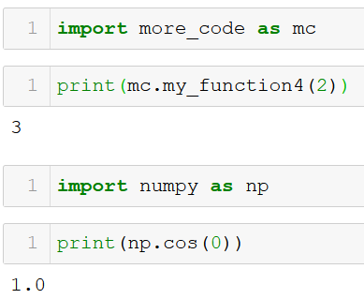
Importing an entire module
more_code.py file
You can also use an alias for the module using the as keyword, as before.
Typically, we often do it with the Numpy library!
import numpy as np
In our notebook

Slide 9
Folders to import from
Observation: Python imported functions from my_code.py, which was located in the same folder as my Notebook.
But there was no numpy.py file in this location.
What happened?
Python looks for files in your current folder first,
And then looks in your Python installation directory.
When you installed the Numpy package with pip on Week 1, you downloaded some numpy files and stored them in your Python installation folder!

Slide 10
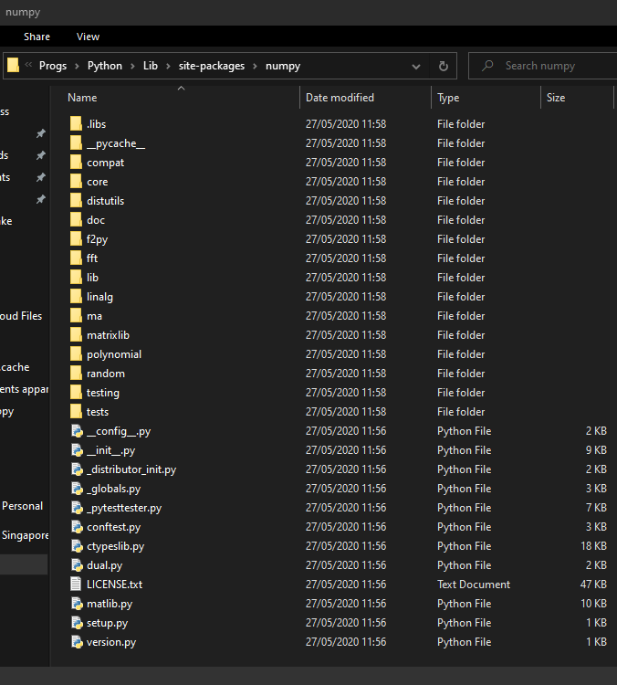
Folders to import from
Python looks for files in your current folder first,
And then looks in your Python installation directory.
When you installed the Numpy package with pip on Week 1, you downloaded some numpy files and stored them in your Python installation folder!

Slide 11
Project organizing
Question: How to organize your code/projects, when you start to have many functions working together?
In many projects, several developers will often collaborate on a single project.
And each one of them will end up working on a single aspect of the project.
E.g. in a video game:
One developer can design the main character,
Another one will develop enemies,
Another one will develop items and weapons,
Another one will design the map/environment in which heroes and enemies evolve,
Etc.

Slide 12
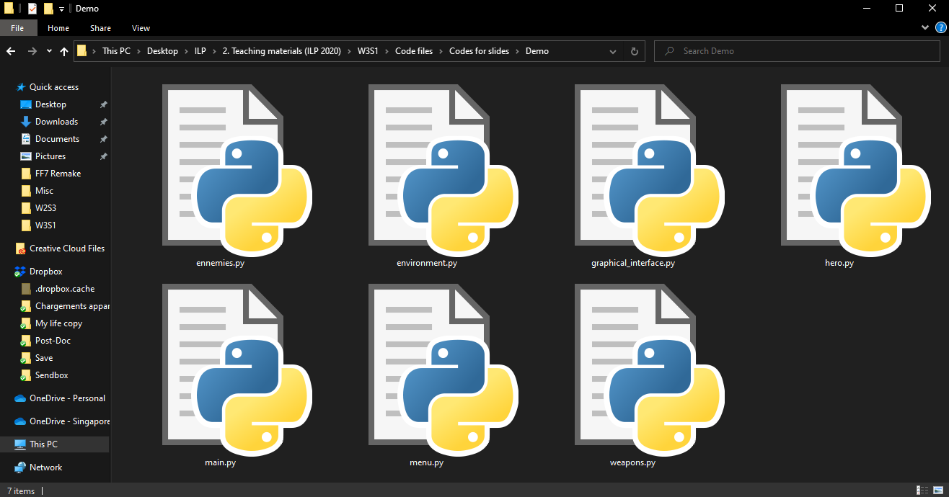

Slide 13
Project organizing
In practice,
Each developer will then work on his/her own .py file, taking care of his/her specific subtask.
Later on, other developers might import functions from files created by other people.
Eventually assemble all pieces in a main.py file!
This is something very common in programming projects.
Important: If your code will be reused by other people, even though they have not coded it, you need to build the habit of documenting your functions! (Otherwise, they will need to read your code to understand it and they will hate you for it)

Slide 14
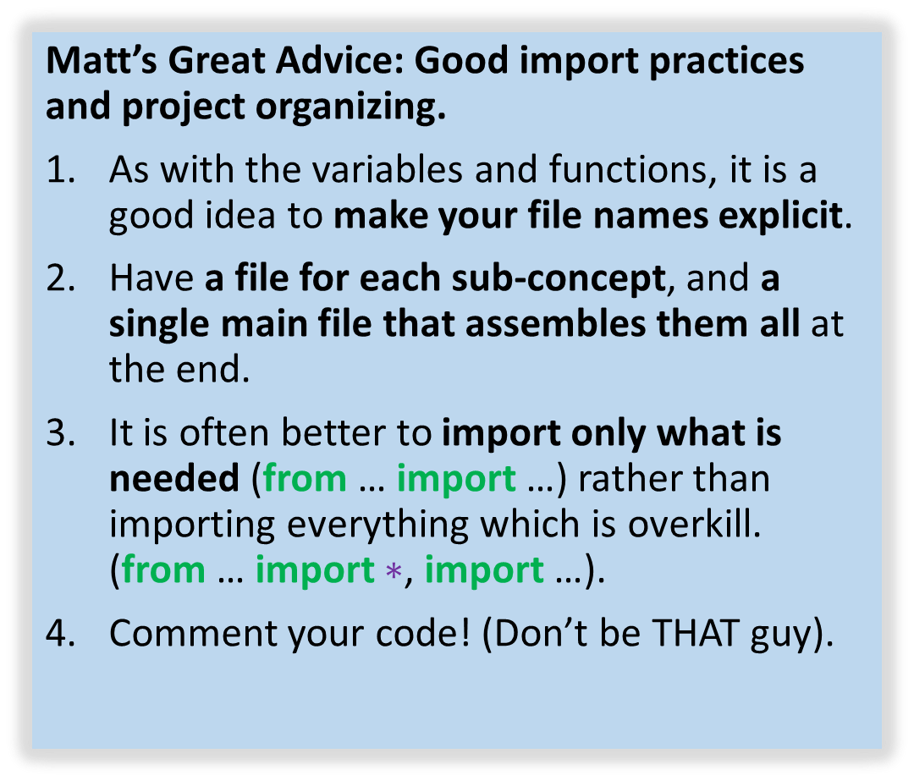
Matt’s Great advice
Matt’s Great Advice: Good import practices and project organizing.
As with the variables and functions, it is a good idea to make your file names explicit.
Have a file for each sub-concept, and a single main file that assembles them all at the end.
It is often better to import only what is needed (from … import …) rather than importing everything which is overkill. (from … import $∗$, import …).
Comment your code! (Don’t be THAT guy).

Slide 15
Conclusion (Chapter 12)
What is the import procedure doing exactly?
How to organize your different codes for better project organizing?
Our first mini-project.

Slide 16
Let us move on to our first Mini-project now!
Wait for me to explain and show you first.

